Slide 1
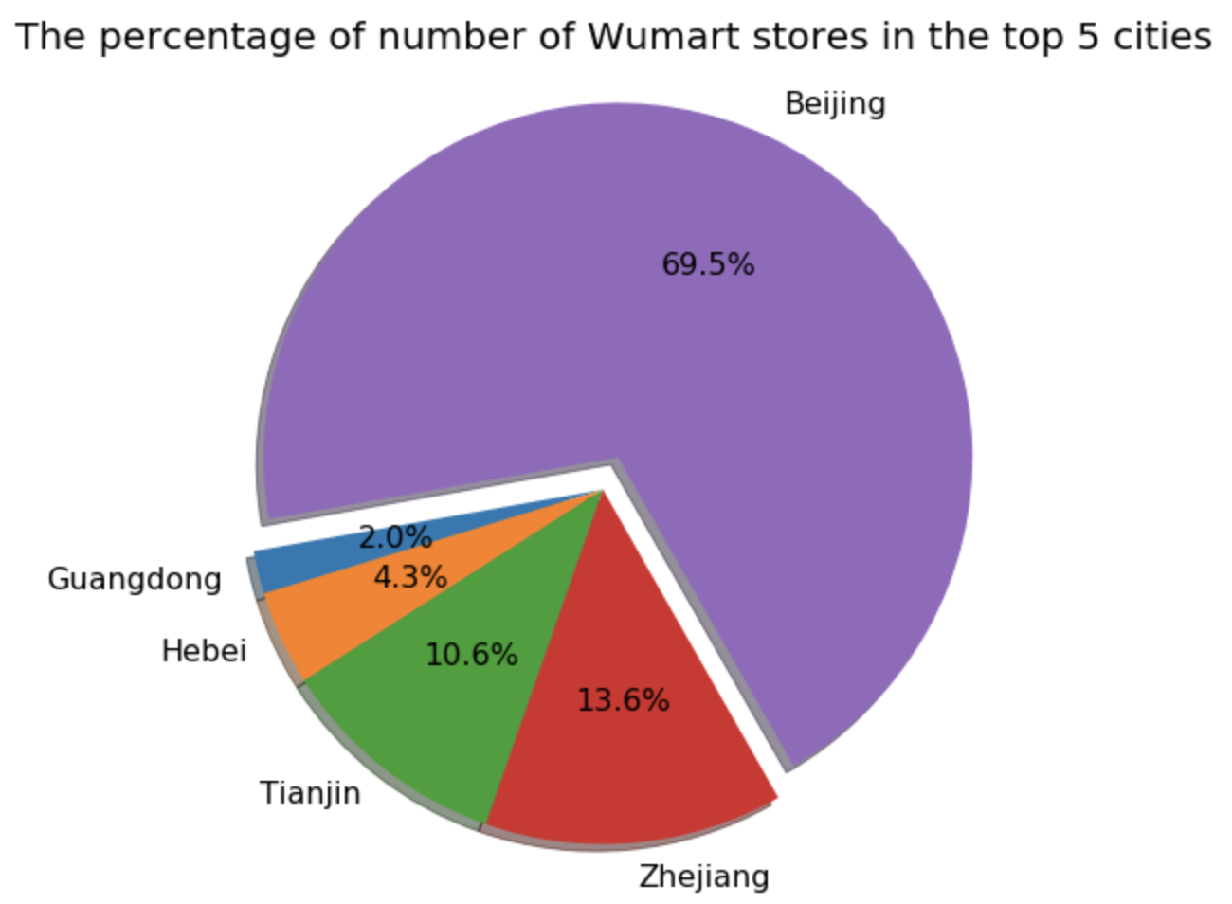
As we could see from the right pie chart, Beijing has the majority number of stores of Wumart.
This piece of information helps us to first focus on Beijing, and gain insights into the potential competition between Wumart and Metro China across the country.
Potential Competitions?

Slide 2
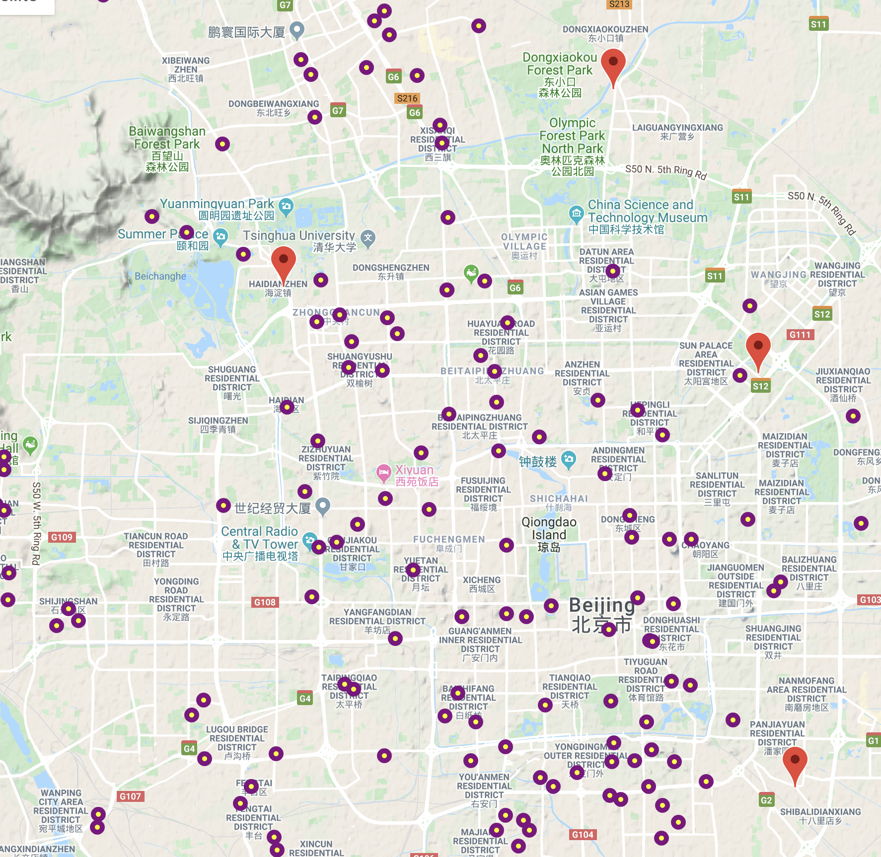


Plot locations of Metro and Wumart stores in Beijing
We could see that the number of Metro stores (# = 4) are far less and the locations are sparser than Wumart( # > 100). This could leave us an impression that there isn’t much potential competition.
However, if we dig deep into calculating the relative distance between each pair, there are some pairs we do need to worry about.
Metro
Wumart

Slide 3
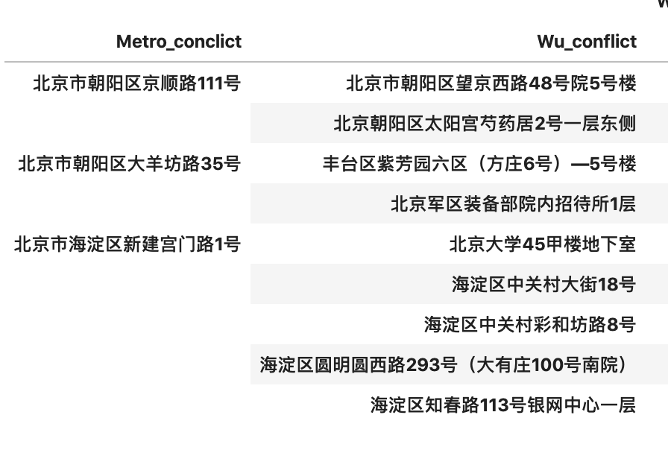
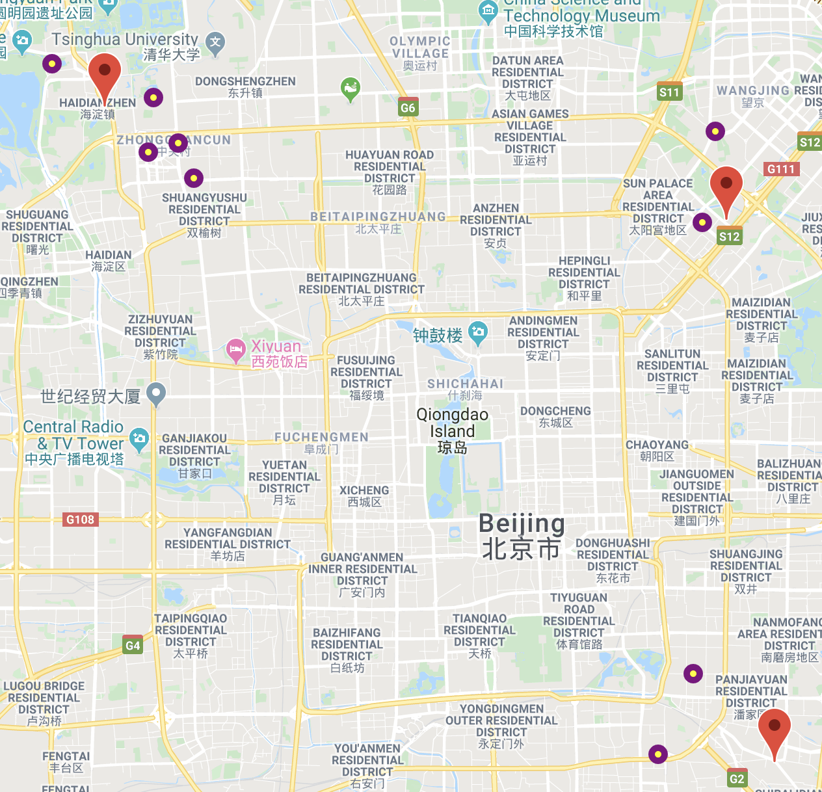
Plot locations of Metro and Wumart who are <3 km away from each other
Metro
Here is the list of potential competitive stores( left col = Metro, right col = Wumart), which should probably be put under consideration.
Wumart

